Slide 1

Stage 3 The Original World Champion Lean Course Designer: Christian Sailer and Marcel Englmaier
The Original World Champion Lean is a 25 round, 125 point Comstock long course. There are 10 IPSC targets and 5 steel targets. The best two hits per target will score. Steel must fall to score. The start signal is audible.
The Handgun start position is standing with toes touching either set of marks and wrists below belt. Handgun is loaded and holstered. The PCC start position is standing with toes touching either set of marks with PCC loaded, stock on belt, safety on.
On the audible start signal, engage all targets from within the shooting area.

Slide 2
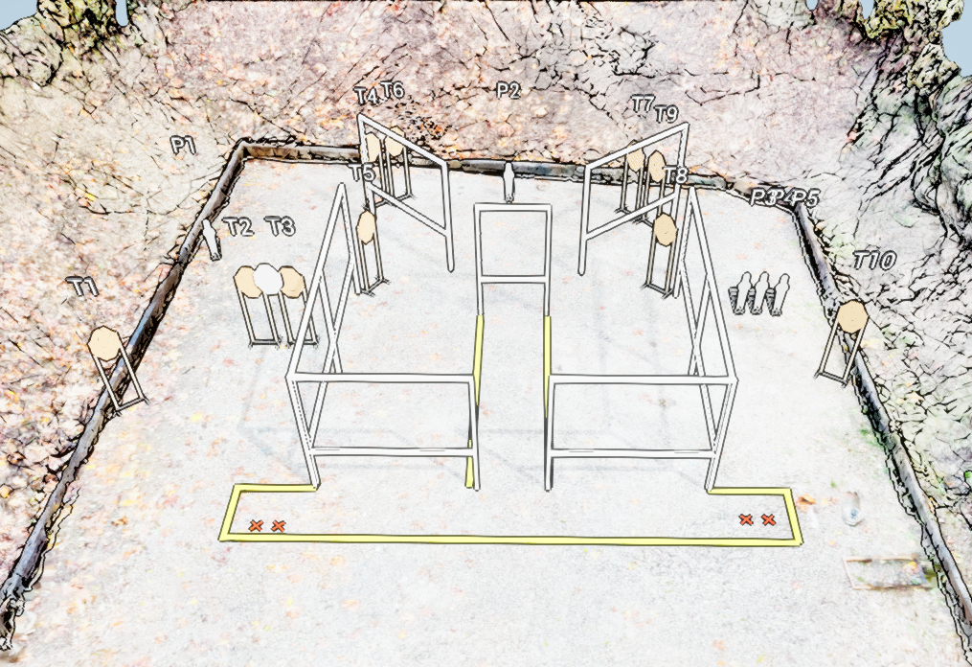
 | Stage 3 The Original World Champion Lean Course Designer: Christian Sailer and Marcel Englmaier

